Slide 1
Buiild_detection_train_loader
Cfg – Configuration file
Mapper – Data Mapper
Fashion_metadata
DatasetCatalog(df=train)
MetadataCatalog.set(classes=df_catergories.name)
Cfg - Config File
Merge config from file rcnn_R50_FPN
DATASET.TRAIN = train
DATASET.TEST = [] (nothing)?
DATALOADER.NUM_WOREKERS=1
MODEL.WEIGHTS= file rcnn_R50_FPN
resizeImages (avoiding memory problems)
IMGS_PER_BATCH=1
BASE_LearningRate=0.00025
MAX_ITER
Set RegionOfIntrests 128 per image (ROI)
Set NUM_OF_PREDICTED_CLASSES=46 (in 2020)

Slide 2
DATALOADER
ASPECT_RATIO_GROUPING: true
FILTER_EMPTY_ANNOTATIONS: true
NUM_WORKERS: 1
REPEAT_THRESHOLD: 0.0
SAMPLER_TRAIN: TrainingSampler
DATASETS:
PRECOMPUTED_PROPOSAL_TOPK_TEST: 1000
PRECOMPUTED_PROPOSAL_TOPK_TRAIN: 2000
PROPOSAL_FILES_TEST: []
PROPOSAL_FILES_TRAIN: []
TEST:
- sample_fashion_test
TRAIN:
- 1sample_fashion_train
GLOBAL:
HACK: 1.0
INPUT:
CROP:
ENABLED: false
SIZE:
- 0.9
- 0.9
TYPE: relative_range
FORMAT: BGR
MASK_FORMAT: polygon
MAX_SIZE_TEST: 60
MAX_SIZE_TRAIN: 60
MIN_SIZE_TEST: 40
MIN_SIZE_TRAIN: - 40
MIN_SIZE_TRAIN_SAMPLING: choice
RANDOM_FLIP: horizontal
Solver
AMP:
ENABLED: false
BASE_LR: 0.00025
BIAS_LR_FACTOR: 1.0
CHECKPOINT_PERIOD: 5000
CLIP_GRADIENTS:
CLIP_TYPE: value
CLIP_VALUE: 1.0
ENABLED: false
NORM_TYPE: 2.0
GAMMA: 0.1
IMS_PER_BATCH: 1
LR_SCHEDULER_NAME: WarmupMultiStepLR
MAX_ITER: 50
MOMENTUM: 0.9
NESTEROV: false
REFERENCE_WORLD_SIZE: 0
STEPS:
[ - 210000 - 250000 ]
WARMUP_FACTOR: 0.001
WARMUP_ITERS: 1000
WARMUP_METHOD: linear
WEIGHT_DECAY: 0.0001
WEIGHT_DECAY_BIAS: 0.0001
WEIGHT_DECAY_NORM: 0.0
TEST:
AUG:
ENABLED: false
FLIP: true
MAX_SIZE: 4000
MIN_SIZES:
[ - 400 - 500 - 600 - 700 - 800
- 900 - 1000 - 1100 - 1200 ]
DETECTIONS_PER_IMAGE: 100
EVAL_PERIOD: 0
EXPECTED_RESULTS: []
KEYPOINT_OKS_SIGMAS: []
PRECISE_BN:
ENABLED: false
NUM_ITER: 200
Extras
CUDNN_BENCHMARK: false
Version: 2
VIS_PERIOD: 0

Slide 3
Model – pt5
ANCHOR_GENERATOR:
ANGLES:
[ - - -90 - 0 - 90 ]
ASPECT_RATIOS:
[ - - 0.5 - 1.0 - 2.0 ]
NAME: DefaultAnchorGenerator
OFFSET: 0.0
SIZES:
[ - - 32 - - 64 - - 128 - - 256 - - 512 ]
BACKBONE:
FREEZE_AT: 2
NAME: build_resnet_fpn_backbone
DEVICE: cuda
FPN:
FUSE_TYPE: sum
IN_FEATURES:
[ - res2 - res3 - res4 - res5 ]
NORM: ''
OUT_CHANNELS: 256
KEYPOINT_ON: false
LOAD_PROPOSALS: false
MASK_ON: true
META_ARCHITECTURE: GeneralizedRCNN
PANOPTIC_FPN:
COMBINE:
ENABLED: true
INSTANCES_CONFIDENCE_THRESH: 0.5
OVERLAP_THRESH: 0.5
STUFF_AREA_LIMIT: 4096
INSTANCE_LOSS_WEIGHT: 1.0
PIXEL_MEAN:
[ - 103.53 - 116.28 - 123.675 ]
PIXEL_STD:
[ - 1.0 - 1.0 - 1.0 ]
Model – pt6
LOSS_WEIGHT: 1.0
MIN_KEYPOINTS_PER_IMAGE: 1
NAME: KRCNNConvDeconvUpsampleHead
NORMALIZE_LOSS_BY_VISIBLE_KEYPOINTS: true
NUM_KEYPOINTS: 17
POOLER_RESOLUTION: 14
POOLER_SAMPLING_RATIO: 0
POOLER_TYPE: ROIAlignV2
ROI_MASK_HEAD:
CLS_AGNOSTIC_MASK: false
CONV_DIM: 256
NAME: MaskRCNNConvUpsampleHead
NORM: ''
NUM_CONV: 4
POOLER_RESOLUTION: 14
POOLER_SAMPLING_RATIO: 0
POOLER_TYPE: ROIAlignV2
RPN:
BATCH_SIZE_PER_IMAGE: 256
BBOX_REG_LOSS_TYPE: smooth_l1
BBOX_REG_LOSS_WEIGHT: 1.0
BBOX_REG_WEIGHTS:
[ - 1.0 - 1.0 - 1.0 - 1.0]
BOUNDARY_THRESH: -1
HEAD_NAME: StandardRPNHead
IN_FEATURES:
[ - p2 - p3 - p4 - p5 - p6 ]
IOU_LABELS:
[ - 0 - -1 - 1 ]
IOU_THRESHOLDS:
[ - 0.3 - 0.7 ]
Model – pt7
LOSS_WEIGHT: 1.0
NMS_THRESH: 0.7
POSITIVE_FRACTION: 0.5
POST_NMS_TOPK_TEST: 1000
POST_NMS_TOPK_TRAIN: 1000
PRE_NMS_TOPK_TEST: 1000
PRE_NMS_TOPK_TRAIN: 2000
SMOOTH_L1_BETA: 0.0
SEM_SEG_HEAD:
COMMON_STRIDE: 4
CONVS_DIM: 128
IGNORE_VALUE: 255
IN_FEATURES:
[ - p2 - p3 - p4 - p5 ]
LOSS_WEIGHT: 1.0
NAME: SemSegFPNHead
NORM: GN
NUM_CLASSES: 54
WEIGHTS: ./output/model_final.pth

Slide 4
Model - pt1
ANCHOR_GENERATOR:
ANGLES:
[ - - -90 - 0 - 90 ]
ASPECT_RATIOS:
[ - - 0.5 - 1.0 - 2.0 ]
NAME: DefaultAnchorGenerator
OFFSET: 0.0
SIZES:
[ - - 32 - - 64 - - 128 - - 256 - - 512 ]
BACKBONE:
FREEZE_AT: 2
NAME: build_resnet_fpn_backbone
DEVICE: cuda
FPN:
FUSE_TYPE: sum
IN_FEATURES:
[ - res2 - res3 - res4 - res5 ]
NORM: ''
OUT_CHANNELS: 256
KEYPOINT_ON: false
LOAD_PROPOSALS: false
MASK_ON: true
META_ARCHITECTURE: GeneralizedRCNN
PANOPTIC_FPN:
COMBINE:
ENABLED: true
INSTANCES_CONFIDENCE_THRESH: 0.5
OVERLAP_THRESH: 0.5
STUFF_AREA_LIMIT: 4096
INSTANCE_LOSS_WEIGHT: 1.0
PIXEL_MEAN:
[ - 103.53 - 116.28 - 123.675 ]
PIXEL_STD:
[ - 1.0 - 1.0 - 1.0 ]
Model - pt2
PROPOSAL_GENERATOR:
MIN_SIZE: 0
NAME: RPN
RESNETS:
DEFORM_MODULATED: false
DEFORM_NUM_GROUPS: 1
DEFORM_ON_PER_STAGE:
[ - false - false - false - false ]
DEPTH: 50
NORM: FrozenBN
NUM_GROUPS: 1
OUT_FEATURES:
[ - res2 - res3 - res4 - res5]
RES2_OUT_CHANNELS: 256
RES5_DILATION: 1
STEM_OUT_CHANNELS: 64
STRIDE_IN_1X1: true
WIDTH_PER_GROUP: 64
RETINANET:
BBOX_REG_LOSS_TYPE: smooth_l1
BBOX_REG_WEIGHTS:
[ - 1.0 - 1.0 - 1.0 - 1.0]
FOCAL_LOSS_ALPHA: 0.25
FOCAL_LOSS_GAMMA: 2.0
IN_FEATURES:
[ - p3 - p4 - p5 - p6 - p7 ]
IOU_LABELS:
[ - 0 - -1 - 1 ]
IOU_THRESHOLDS:
[ - 0.4 - 0.5 ]
RETINANET:
BBOX_REG_LOSS_TYPE: smooth_l1
BBOX_REG_WEIGHTS:
[ - 1.0 - 1.0 - 1.0 - 1.0]
FOCAL_LOSS_ALPHA: 0.25
FOCAL_LOSS_GAMMA: 2.0
Model – pt3
IN_FEATURES:
[ - p3 - p4 - p5 - p6 - p7 ]
IOU_LABELS:
[ - 0 - -1 - 1 ]
IOU_THRESHOLDS:
[ - 0.4 - 0.5 ]
RETINANET:
BBOX_REG_LOSS_TYPE: smooth_l1
BBOX_REG_WEIGHTS:
[ - 1.0 - 1.0 - 1.0 - 1.0]
FOCAL_LOSS_ALPHA: 0.25
FOCAL_LOSS_GAMMA: 2.0
IN_FEATURES:
[ - p3 - p4 - p5 - p6 - p7 ]
IOU_LABELS:
[ - 0 - -1 - 1 ]
IOU_THRESHOLDS:
[ - 0.4 - 0.5 ]
NMS_THRESH_TEST: 0.5
NORM: ''
NUM_CLASSES: 80
NUM_CONVS: 4
PRIOR_PROB: 0.01
SCORE_THRESH_TEST: 0.05
SMOOTH_L1_LOSS_BETA: 0.1
TOPK_CANDIDATES_TEST: 1000
ROI_BOX_CASCADE_HEAD:
BBOX_REG_WEIGHTS:
[ - - 10.0 - 10.0 - 5.0 - 5.0 - - 20.0 - 20.0
- 10.0 - 10.0 - - 30.0 - 30.0 - 15.0 - 15.0 ]
IOUS:
[ - 0.5 - 0.6 - 0.7 ]
ROI_BOX_HEAD:
BBOX_REG_LOSS_TYPE: smooth_l1
BBOX_REG_LOSS_WEIGHT: 1.0
BBOX_REG_WEIGHTS:
[ - 10.0 - 10.0 - 5.0 - 5.0 ]
Model – pt3
CLS_AGNOSTIC_BBOX_REG: false
CONV_DIM: 256
FC_DIM: 1024
NAME: FastRCNNConvFCHead
NORM: ''
NUM_CONV: 0
NUM_FC: 2
POOLER_RESOLUTION: 7
POOLER_SAMPLING_RATIO: 0
POOLER_TYPE: ROIAlignV2
SMOOTH_L1_BETA: 0.0
TRAIN_ON_PRED_BOXES: false
ROI_HEADS:
BATCH_SIZE_PER_IMAGE: 128
IN_FEATURES:
[ - p2 - p3 - p4 - p5 ]
IOU_LABELS:
[ - 0 - 1 ]
IOU_THRESHOLDS:
- 0.5
NAME: StandardROIHeads
NMS_THRESH_TEST: 0.5
NUM_CLASSES: 46
POSITIVE_FRACTION: 0.25
PROPOSAL_APPEND_GT: true
SCORE_THRESH_TEST: 0.5
CLS_AGNOSTIC_BBOX_REG: false
CONV_DIM: 256
FC_DIM: 1024
NAME: FastRCNNConvFCHead
NORM: ''
NUM_CONV: 0
NUM_FC: 2
POOLER_RESOLUTION: 7
POOLER_SAMPLING_RATIO: 0
POOLER_TYPE: ROIAlignV2
SMOOTH_L1_BETA: 0.0
TRAIN_ON_PRED_BOXES: false
ROI_HEADS:
BATCH_SIZE_PER_IMAGE: 128
IN_FEATURES:
[ - p2 - p3 - p4 - p5 ]
IOU_LABELS:
[ - 0 - 1 ]
IOU_THRESHOLDS:
- 0.5
NAME: StandardROIHeads
NMS_THRESH_TEST: 0.5
NUM_CLASSES: 46
POSITIVE_FRACTION: 0.25
PROPOSAL_APPEND_GT: true
SCORE_THRESH_TEST: 0.5
ROI_KEYPOINT_HEAD:
CONV_DIMS:
[ - 512 - 512 - 512 - 512 - 512 - 512 - 512 - 512
LOSS_WEIGHT: 1.0
MIN_KEYPOINTS_PER_IMAGE: 1
NAME: KRCNNConvDeconvUpsampleHead
NORMALIZE_LOSS_BY_VISIBLE_KEYPOINTS: true
NUM_KEYPOINTS: 17
POOLER_RESOLUTION: 14
POOLER_SAMPLING_RATIO: 0
POOLER_TYPE: ROIAlignV2
ROI_MASK_HEAD:
CLS_AGNOSTIC_MASK: false
CONV_DIM: 256
NAME: MaskRCNNConvUpsampleHead
NORM: ''
NUM_CONV: 4
POOLER_RESOLUTION: 14
POOLER_SAMPLING_RATIO: 0
POOLER_TYPE: ROIAlignV2
RPN:
BATCH_SIZE_PER_IMAGE: 256
BBOX_REG_LOSS_TYPE: smooth_l1
BBOX_REG_LOSS_WEIGHT: 1.0
BBOX_REG_WEIGHTS:
[ - 1.0 - 1.0 - 1.0 - 1.0]
BOUNDARY_THRESH: -1
HEAD_NAME: StandardRPNHead
IN_FEATURES:
[ - p2 - p3 - p4 - p5 - p6 ]
IOU_LABELS:
[ - 0 - -1 - 1 ]
IOU_THRESHOLDS:
[ - 0.3 - 0.7 ]
LOSS_WEIGHT: 1.0
NMS_THRESH: 0.7
POSITIVE_FRACTION: 0.5
POST_NMS_TOPK_TEST: 1000
POST_NMS_TOPK_TRAIN: 1000
PRE_NMS_TOPK_TEST: 1000
PRE_NMS_TOPK_TRAIN: 2000
SMOOTH_L1_BETA: 0.0
SEM_SEG_HEAD:
COMMON_STRIDE: 4
CONVS_DIM: 128
IGNORE_VALUE: 255
IN_FEATURES:
[ - p2 - p3 - p4 - p5 ]
LOSS_WEIGHT: 1.0
NAME: SemSegFPNHead
NORM: GN
NUM_CLASSES: 54
WEIGHTS: ./output/model_final.pth

Slide 5
DataMapper Drawings - DataLoader
The DefaultDatasetLoader – a callable that does the following:
Read the image from “file_name”
Applies cropping/geometric transforms to the image and annotations
Prepare data and annotations to Tensor and Instance
detectron2format:
Notes:
import copy
from detectron2.data import build_detection_train_loader, build_detection_test_loader
from detectron2.data import transforms as T
from detectron2.data import detection_utils as utils
class DatasetMapper:
"""
A callable which takes a dataset dict in Detectron2 Dataset format,
and map it into a format used by the model.
This is a custom version of the DatasetMapper. The only different with Detectron2's
DatasetMapper is that we extract attributes from our photo_dict.
"""
def __init__(self, cfg, is_train=True):
## if training: crop
if cfg.INPUT.CROP.ENABLED and is_train:
self.crop_gen = T.RandomCrop(cfg.INPUT.CROP.TYPE, cfg.INPUT.CROP.SIZE)
logging.getLogger(__name__).info("CropGen used in training: " + str(self.crop_gen))
else:
self.crop_gen = None
## ???
self.tfm_gens = utils.build_transform_gen(cfg, is_train)
# fmt: off ??? format??
self.img_format = cfg.INPUT.FORMAT
self.mask_on = cfg.MODEL.MASK_ON
self.mask_format = cfg.INPUT.MASK_FORMAT
self.keypoint_on = cfg.MODEL.KEYPOINT_ON
self.load_proposals = cfg.MODEL.LOAD_PROPOSALS
# fmt: on
# Horizontal flipping?
if self.keypoint_on and is_train:
# Flip only makes sense in training (Only creating this augmentation, not using it yet..)
self.keypoint_hflip_indices = utils.create_keypoint_hflip_indices(cfg.DATASETS.TRAIN)
else:
self.keypoint_hflip_indices = None
# Load proposals ( Region Proposoals )
if self.load_proposals:
# Minimum (highet or length)
self.min_box_side_len = cfg.MODEL.PROPOSAL_GENERATOR.MIN_SIZE
self.proposal_topk = (
cfg.DATASETS.PRECOMPUTED_PROPOSAL_TOPK_TRAIN
if is_train
else cfg.DATASETS.PRECOMPUTED_PROPOSAL_TOPK_TEST
)
self.is_train = is_train
def __call__(self, photo_dict):
"""
Args:
photo_dict (dict): Metadata of one image, in Detectron2 Dataset format.
Returns:
dict: a format that builtin models in detectron2 accept
"""
# Creating a deep copy, so we wont modify it
photo_dict = copy.deepcopy(photo_dict) # it will be modified by code below
# USER: Write your own image loading if it's not from a file
image = utils.read_image(photo_dict["file_name"], format=self.img_format)
#Raise an error if the image does not match the size specified in the dict
utils.check_image_size(photo_dict, image)
# if there is no annotations in the dict (means that ???)
if "annotations" not in photo_dict:
image, transforms = T.apply_transform_gens(
([self.crop_gen] if self.crop_gen else []) + self.tfm_gens, image
)
else:
# Crop around an instance if there are instances in the image.
# USER: Remove if you don't use cropping
if self.crop_gen:
crop_tfm = utils.gen_crop_transform_with_instance(
self.crop_gen.get_crop_size(image.shape[:2]),
image.shape[:2],
np.random.choice(photo_dict["annotations"]),
)
image = crop_tfm.apply_image(image)
image, transforms = T.apply_transform_gens(self.tfm_gens, image)
if self.crop_gen:
transforms = crop_tfm + transforms
image_shape = image.shape[:2] # h, w
# Pytorch's dataloader is efficient on torch.Tensor due to shared-memory,
# but not efficient on large generic data structures due to the use of pickle & mp.Queue.
# Therefore it's important to use torch.Tensor.
photo_dict["image"] = torch.as_tensor(np.ascontiguousarray(image.transpose(2, 0, 1)))
# USER: Remove if you don't use pre-computed proposals.
if self.load_proposals:
utils.transform_proposals( # https://detectron2.readthedocs.io/en/latest/_modules/detectron2/data/detection_utils.html (min_box_side_len)
photo_dict, image_shape, transforms, self.min_box_side_len, self.proposal_topk
)
# Run on Inference Only:
if not self.is_train:
# USER: Modify this if you want to keep them for some reason.
photo_dict.pop("annotations", None)
photo_dict.pop("sem_seg_file_name", None)
return photo_dict
# annotations = colored pixels Run on inference Only in training:
if "annotations" in photo_dict:
# USER: Modify this if you want to keep them for some reason.
## ??? Why?
for anno in photo_dict["annotations"]:
if not self.mask_on:
anno.pop("segmentation", None)
if not self.keypoint_on:
anno.pop("keypoints", None)
# USER: Implement additional transformations if you have other types of data
annos = [
utils.transform_instance_annotations(
obj, transforms, image_shape, keypoint_hflip_indices=self.keypoint_hflip_indices
)
for obj in photo_dict.pop("annotations") # For every annotaiton
if obj.get("iscrowd", 0) == 0 # if encoding is not RLE
]
instances = utils.annotations_to_instances(
annos, image_shape, mask_format=self.mask_format
)
# Create a tight bounding box from masks, useful when image is cropped
if self.crop_gen and instances.has("gt_masks"):
instances.gt_boxes = instances.gt_masks.get_bounding_boxes()
####################################
# New: Get attributes from annos
####################################
if len(annos) and 'attributes' in annos[0]:
# get a list of list of attributes
gt_attributes = [x['attributes'] for x in annos]
# Put attributes in Attributes class holder and add them to instances
instances.gt_attributes = Attributes(gt_attributes)
photo_dict["instances"] = utils.filter_empty_instances(instances)
# USER: Remove if you don't do semantic/panoptic segmentation.
if "sem_seg_file_name" in photo_dict:
with PathManager.open(photo_dict.pop("sem_seg_file_name"), "rb") as f:
sem_seg_gt = Image.open(f)
sem_seg_gt = np.asarray(sem_seg_gt, dtype="uint8")
sem_seg_gt = transforms.apply_segmentation(sem_seg_gt)
sem_seg_gt = torch.as_tensor(sem_seg_gt.astype("long"))
photo_dict["sem_seg"] = sem_seg_gt
return photo_dict

Slide 6
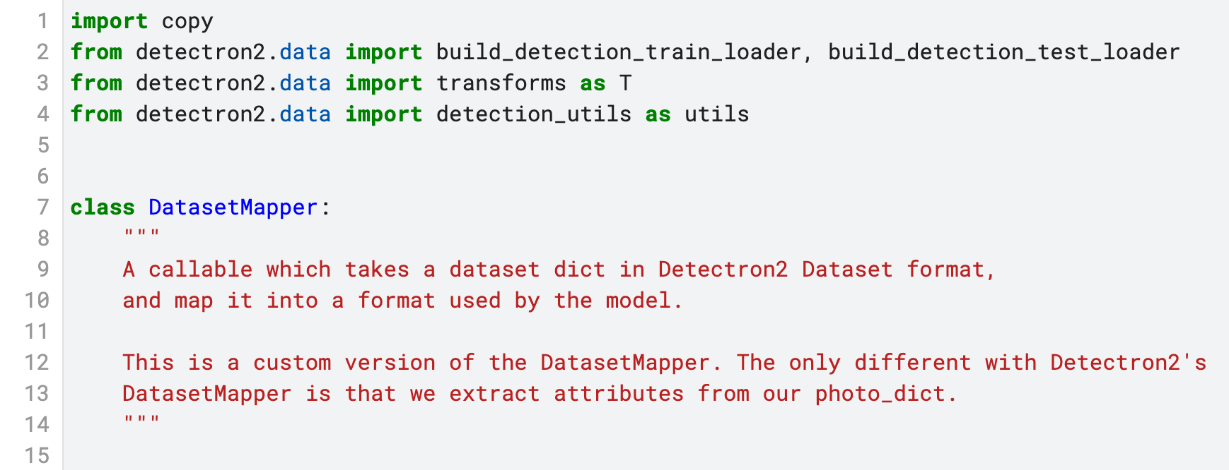
Lines 1 – 15 (Intro)
Lines 1-4
Imports
Line 7
Declaring class (not inherets from anything)
Lines 8-14
Basic explenation of the class’s goal

Slide 7
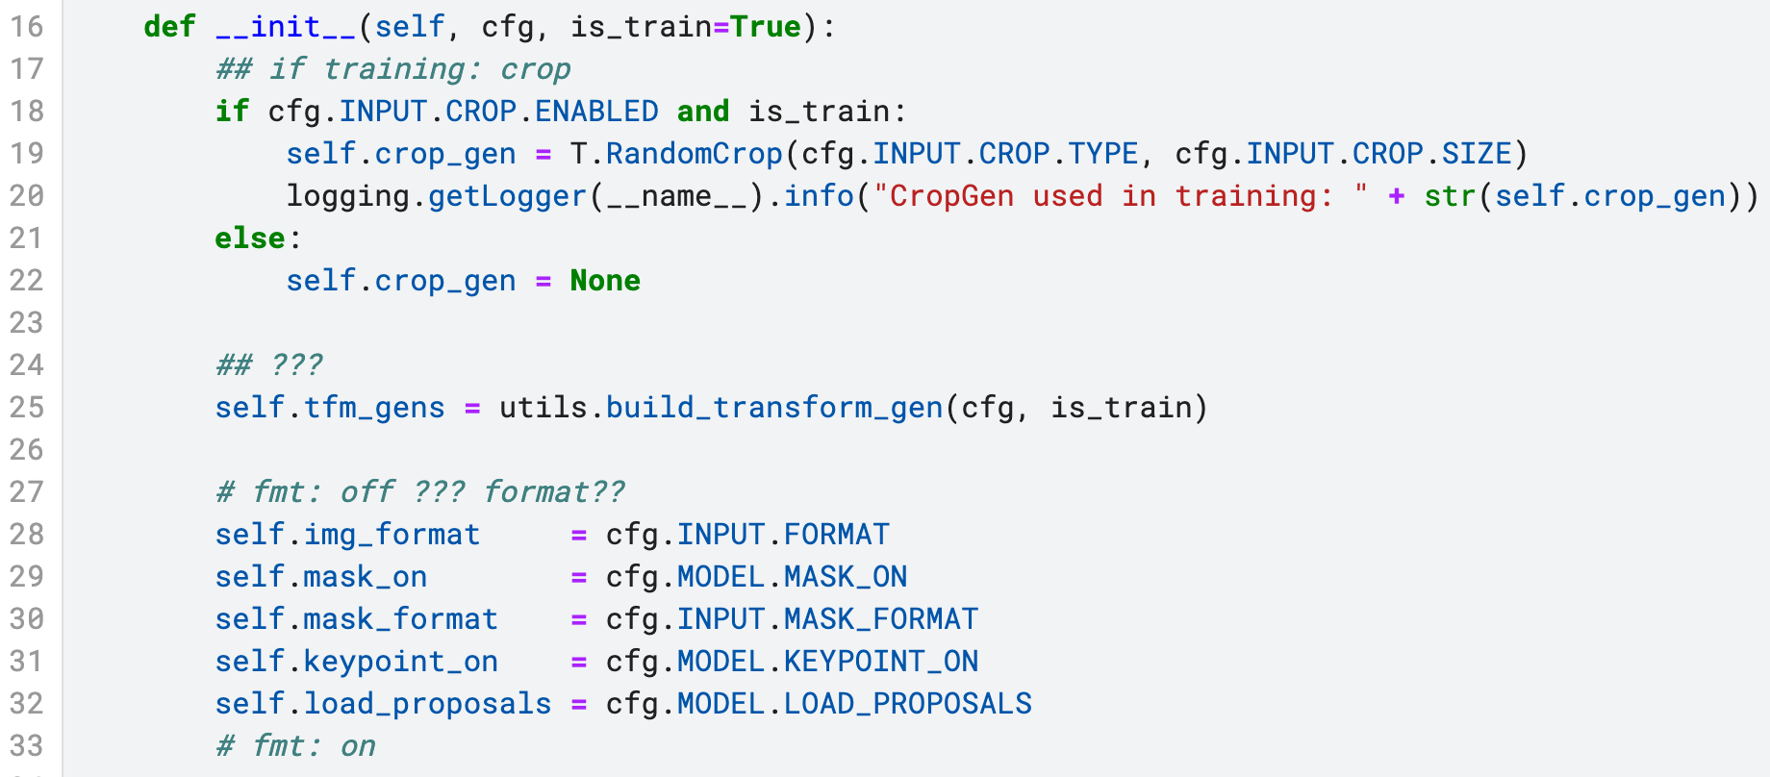
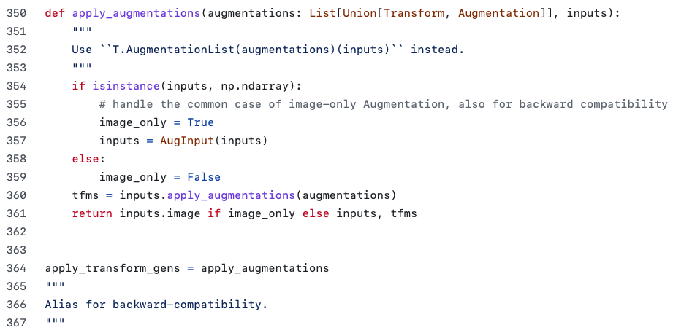
Lines 16 – 33 (init pt1)
Lines 16 - init
Inits the DataMapper (when calling DataMapper(config) )
Lines 18-19
If we are loading train images & in the config file, we enabled cropping:
Crop the image
CROP.TYPE (str): one of "relative_range", "relative", "absolute", "absolute_range".
Line 20
Write into the logging mechanizem the crop we’ve done.
Lines 27 – 33
Set Mapper formats based on config’s file default values
Format: BGR (RGB..)
Mask_on: True
Mask_format: Polygon (Enum probably)
Keypoint_on : False
LOAD_PROPOSALS: False
Line 33 & 27
Fmt?? Format maybe
Lines 24-25 tfm_gens
build_transform_gen – apply transformations: (tfm = transforms)
Notes:
def apply_augmentations(augmentations: List[Union[Transform, Augmentation]], inputs):
"""
Use ``T.AugmentationList(augmentations)(inputs)`` instead.
"""
if isinstance(inputs, np.ndarray):
# handle the common case of image-only Augmentation, also for backward compatibility
image_only = True
inputs = AugInput(inputs)
else:
image_only = False
tfms = inputs.apply_augmentations(augmentations)
return inputs.image if image_only else inputs, tfms
apply_transform_gens = apply_augmentations
"""
Alias for backward-compatibility.
"""

Slide 8
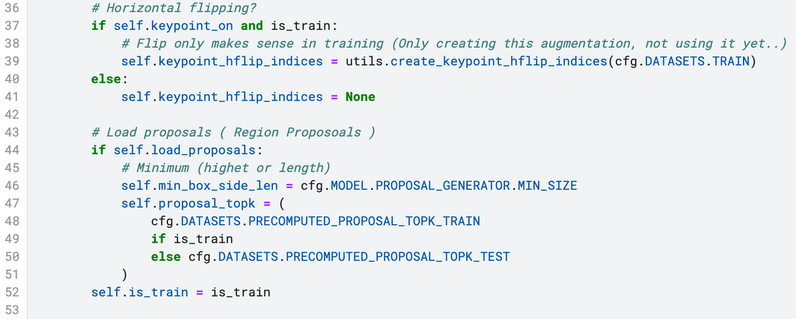
Lines 34 – 53 (init pt2)
Lines 43 – proposoals
If we have known Regions Of Interest (Probably in train only)
Line 46 - Min_box_slide_len
the minimum size of region to propose
proposals with either side smaller than this threshold are removed
Line 47 Proposoal_topK
if given, will load pre-computed proposals from dataset_dict and keep the top k proposals for each image.
Lines37 -39: Keypoints
If we have ground trouth keypoints,
an we want to create Horizontal flip augmentation
Notes:
def apply_augmentations(augmentations: List[Union[Transform, Augmentation]], inputs):
"""
Use ``T.AugmentationList(augmentations)(inputs)`` instead.
"""
if isinstance(inputs, np.ndarray):
# handle the common case of image-only Augmentation, also for backward compatibility
image_only = True
inputs = AugInput(inputs)
else:
image_only = False
tfms = inputs.apply_augmentations(augmentations)
return inputs.image if image_only else inputs, tfms
apply_transform_gens = apply_augmentations
"""
Alias for backward-compatibility.
"""

Slide 9
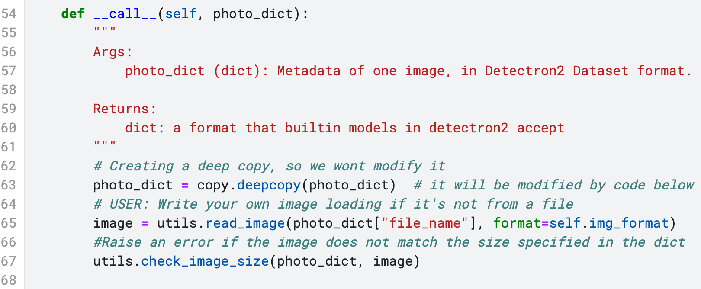
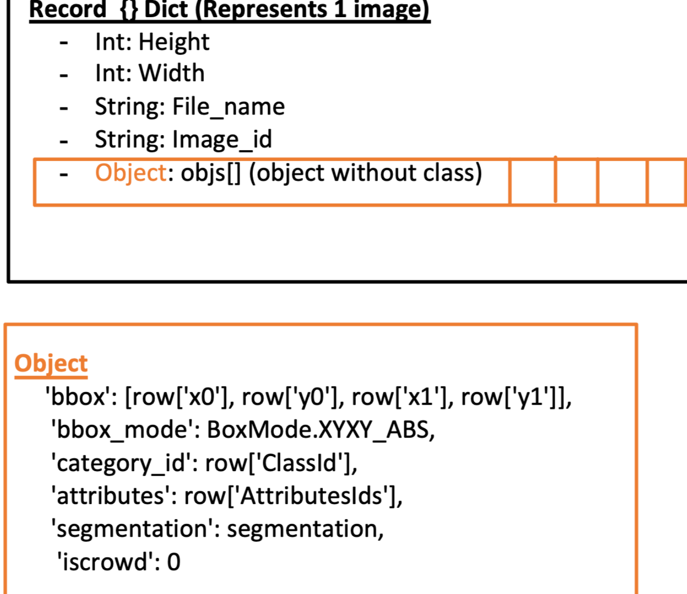
Lines 54 – 68 (call pt1)
Line 54 – init func decleration
Will be called when say object of type DataMapper: will be called with wanted image(s)_representation data_mapper(img_2_dict)
Or data_mapper(batch_of_images) ( We will assume It receives a single image in our writing )
Line 63
Create a deep copy of the image representation
Line 65 read image from disk
Read the image from the disk, given the format (BGR) (like cv2.imread)
Line 67 Check Image Size
Raise an error if the image’s size does not match the size specified in the dict.
TODO: Make sure that this is indeed what the photo_dict looks like
Notes:
def apply_augmentations(augmentations: List[Union[Transform, Augmentation]], inputs):
"""
Use ``T.AugmentationList(augmentations)(inputs)`` instead.
"""
if isinstance(inputs, np.ndarray):
# handle the common case of image-only Augmentation, also for backward compatibility
image_only = True
inputs = AugInput(inputs)
else:
image_only = False
tfms = inputs.apply_augmentations(augmentations)
return inputs.image if image_only else inputs, tfms
apply_transform_gens = apply_augmentations
"""
Alias for backward-compatibility.
"""

Slide 10
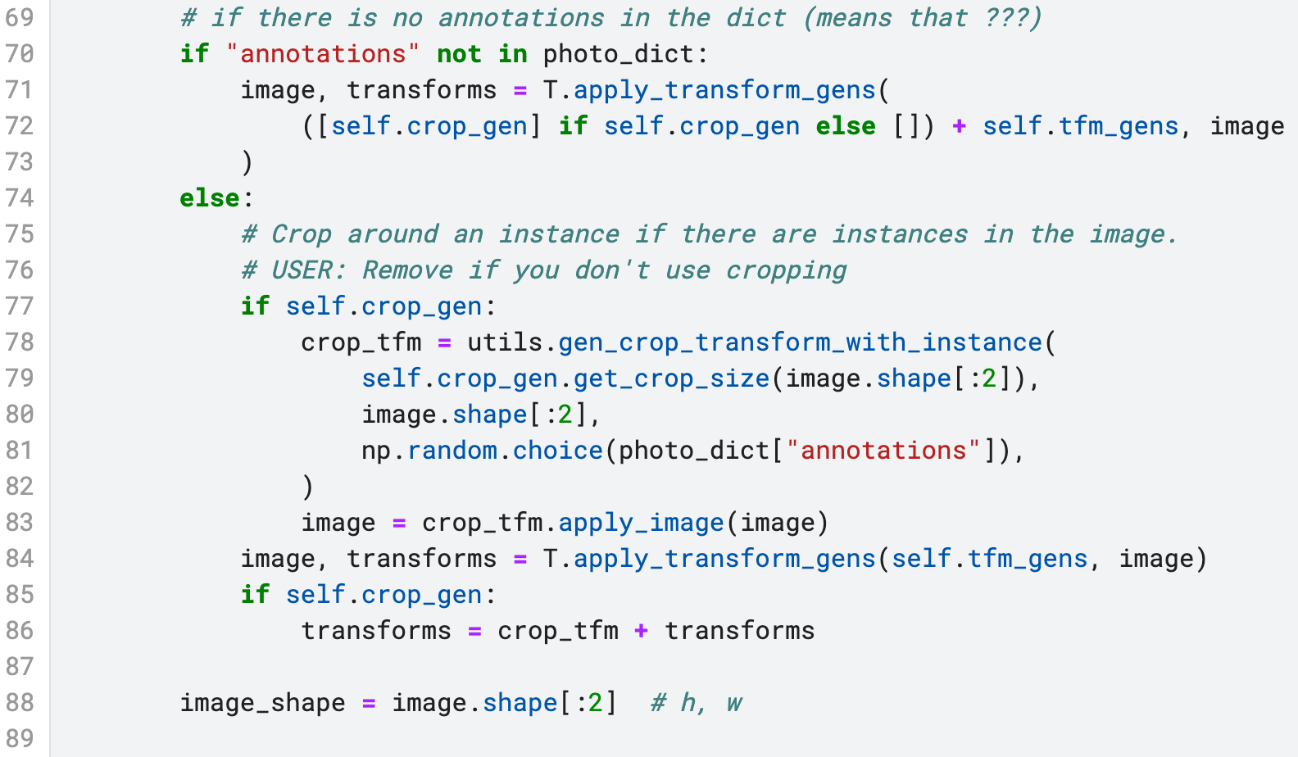
Lines 69 – 89 (call pt2)
Lines 70
if there is no predictions over photo
Line 71
Apply the next augmentations
self.crop_gen (line 19)
Self.tfm_gens
Over image (line 65)
Line 74:
There is annotated predictions over image (train set)
Lines 78
Get crop size of the specific image (crop_gen is general for entire dataset),
“””
Generate a CropTransform so that the cropping region contains
the center of the given instance.
Args:
crop_size (tuple): h, w in pixels
image_size (tuple): h, w
instance (dict): an annotation dict of one instance, in Detectron2's dataset format.
“””
Line 83
Apply the crop transforms on the image
Line 84
Apply augmentations -
(non-crop) transforms (line 25)
Line 85
Append transforms of both types to list
Notes:
def gen_crop_transform_with_instance(crop_size, image_size, instance):
"""
Generate a CropTransform so that the cropping region contains
the center of the given instance.
Args:
crop_size (tuple): h, w in pixels
image_size (tuple): h, w
instance (dict): an annotation dict of one instance, in Detectron2's
dataset format.
"""
crop_size = np.asarray(crop_size, dtype=np.int32)
bbox = BoxMode.convert(instance["bbox"], instance["bbox_mode"], BoxMode.XYXY_ABS)
center_yx = (bbox[1] + bbox[3]) * 0.5, (bbox[0] + bbox[2]) * 0.5
assert (
image_size[0] >= center_yx[0] and image_size[1] >= center_yx[1]
), "The annotation bounding box is outside of the image!"
assert (
image_size[0] >= crop_size[0] and image_size[1] >= crop_size[1]
), "Crop size is larger than image size!"
min_yx = np.maximum(np.floor(center_yx).astype(np.int32) - crop_size, 0)
max_yx = np.maximum(np.asarray(image_size, dtype=np.int32) - crop_size, 0)
max_yx = np.minimum(max_yx, np.ceil(center_yx).astype(np.int32))
y0 = np.random.randint(min_yx[0], max_yx[0] + 1)
x0 = np.random.randint(min_yx[1], max_yx[1] + 1)
return T.CropTransform(x0, y0, crop_size[1], crop_size[0])

Slide 11
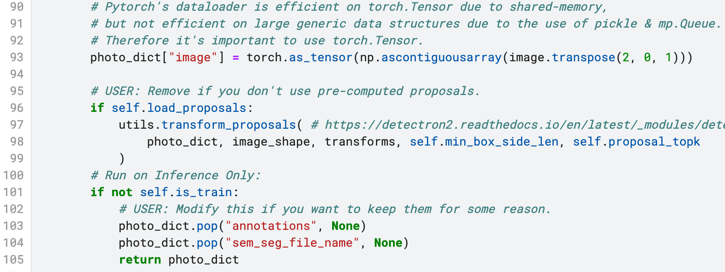
Lines 90 – 105 (call pt3)
Line 90-93
Transform image to torch tensor in shape:
[Color, Height, Width]
Line 96 - transform_proposals
Apply transformations to the proposals in dataset_dict, if any.
Lines 101 - 105 - Test – Return Instance after:
Delete next data from image_dict:
1. Annotations (predictions)
2. Semantic segmentation file name (storing RLE?)
Why file name? fix photo_dict drawing

Slide 12
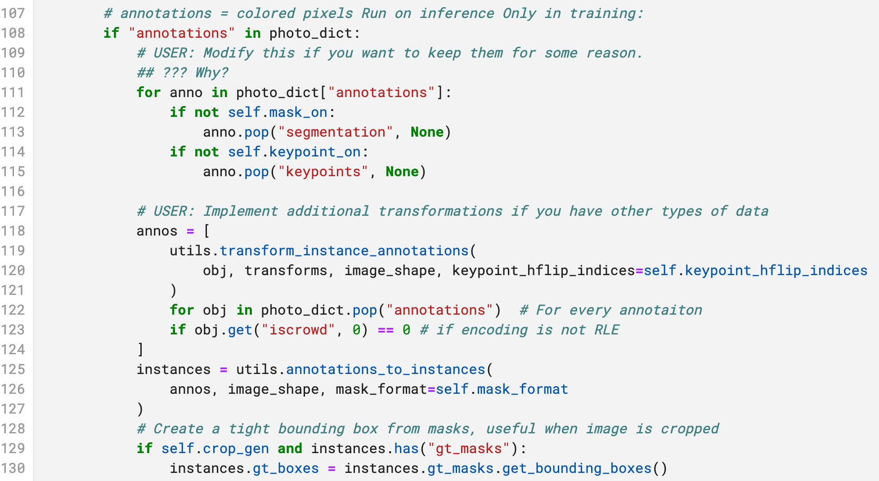
Lines 106 – 131 (call pt4) (for train only, why? -> Line 105)
Line 107 – run only on train
If there is annotations: delete them one by one..
Why?
Line 114 keypoints
Delete Keypoints one by one (why?)
Lines 125-6 annotations_to_instances
A Create an :class:`Instances` object used by the models,
from instance annotations in the dataset dict.
Args:
annos (list[dict]): a list of instance annotations in one image, each
element for one instance.
image_size (tuple): height, width
Returns:
Instances:
It will contain fields "gt_boxes", "gt_classes",
"gt_masks", "gt_keypoints", if they can be obtained from `annos`.
This is the format that builtin models expect.
Instances represent a single image with multiple annotation instances.
Lines 128 – 130
Create a tight bounding box from mask, usefull when image is cropped
Lines 118 – 124 In more Readable Way Utils.transform_instance_annotations (change format of dict)
# Create annotation array
annos = []
# For every annotaiton
for obj in photo_dict.pop("annotations"):
# if encoding is not RLE
if obj.get("iscrowd", 0) == 0:
# Apply transforms to box, segmentation and keypoints annotations of a single instance.
fixed_image_dict = utils.transform_instance_annotations(
obj, transforms, image_shape, keypoint_hflip_indices=self.keypoint_hflip_indices
)
annos.append(fixed_image_dict)

Slide 13
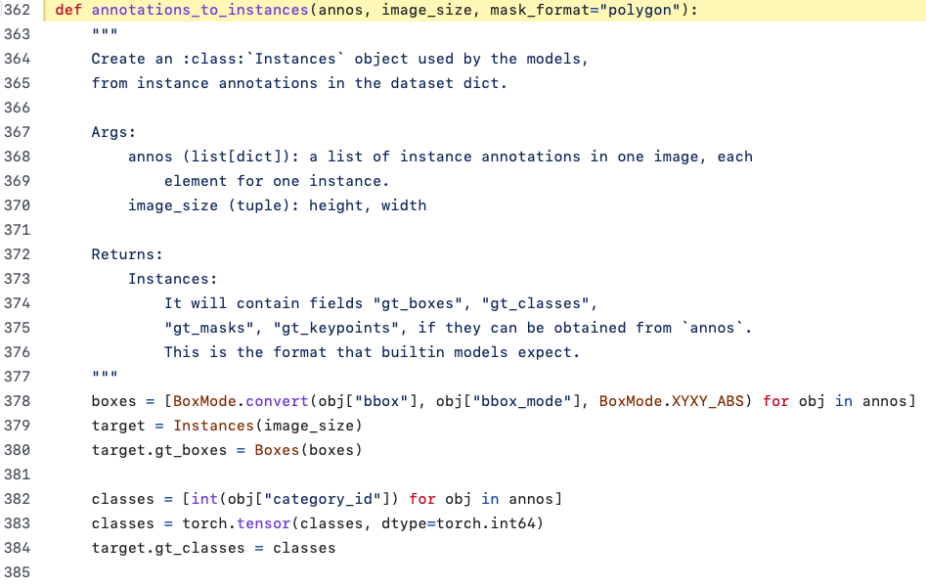
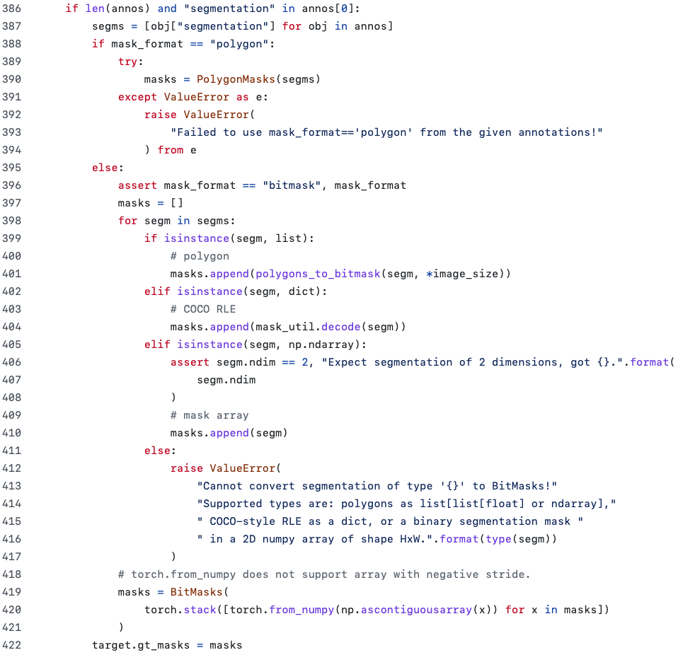
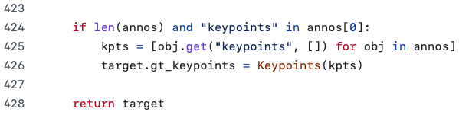
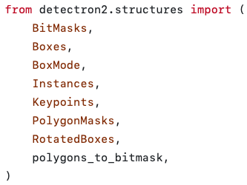
Lines 125 (ANNOTATIONS_TO_INSTANCES & DRAWING)
TARGET : Instance
This class represents a list of instances in an image. It stores the attributes of instances (e.g., boxes, masks, labels, scores) as "fields".
g.t == Ground Trooth

Slide 14
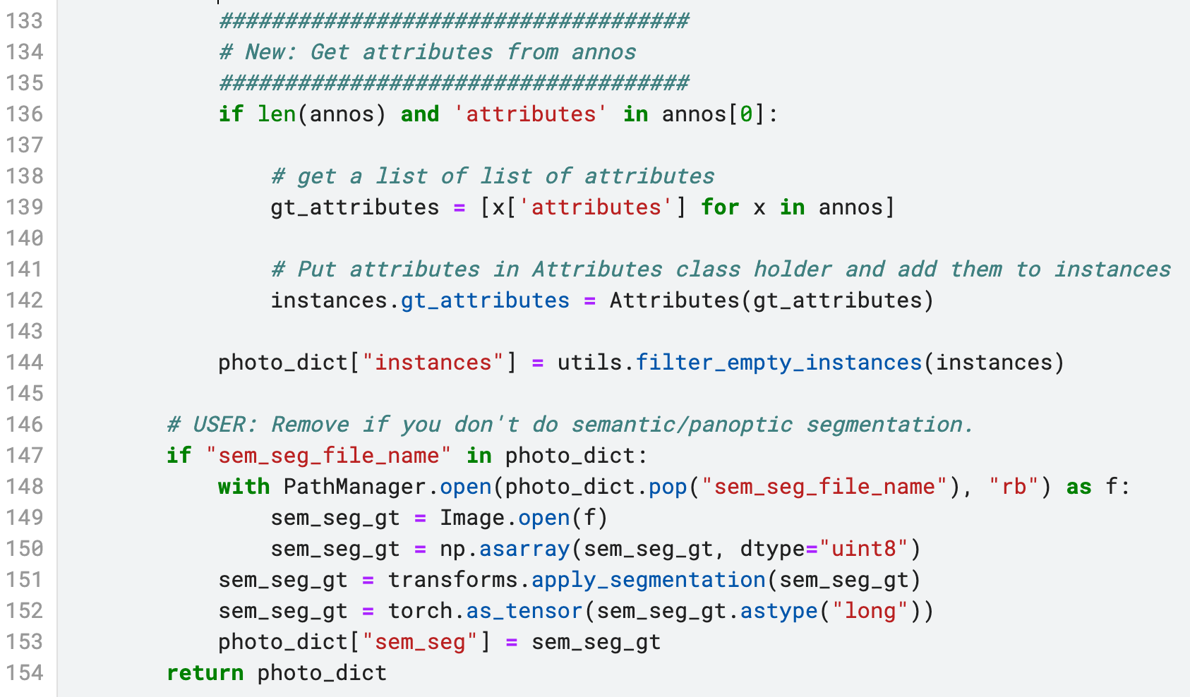
Lines 133 – 154 (call pt5) (for train only, why? -> Line 105)
Line 136 – annos(line 119)
If len of annos > 0 and there is attributes in dict:
Line 139
for each object in annos get the attributes (color, material..)
Lines 144
Filter Empty instances (Why would there be any?)
Lines 146-153
Getting Ground trooth segmentation from a binary file
Apply the segmentation
Turn it into tensor
Lines 118 – 124 In more Readable Way Utils.transform_instance_annotations
# Create annotation array
annos = []
# For every annotaiton
for obj in photo_dict.pop("annotations"):
# if encoding is not RLE
if obj.get("iscrowd", 0) == 0:
# Apply transforms to box, segmentation and keypoints annotations of a single instance.
fixed_image_dict = utils.transform_instance_annotations(
obj, transforms, image_shape, keypoint_hflip_indices=self.keypoint_hflip_indices
)
annos.append(fixed_image_dict)

Slide 15
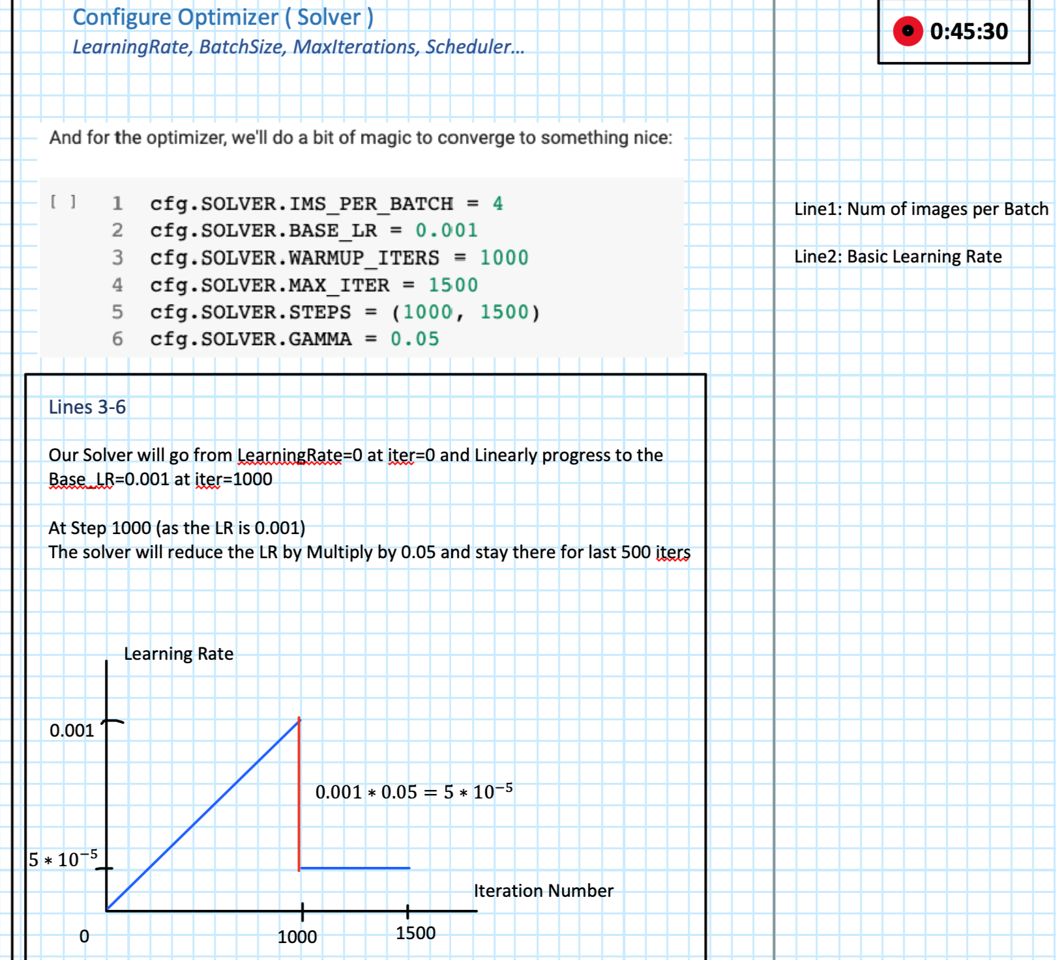
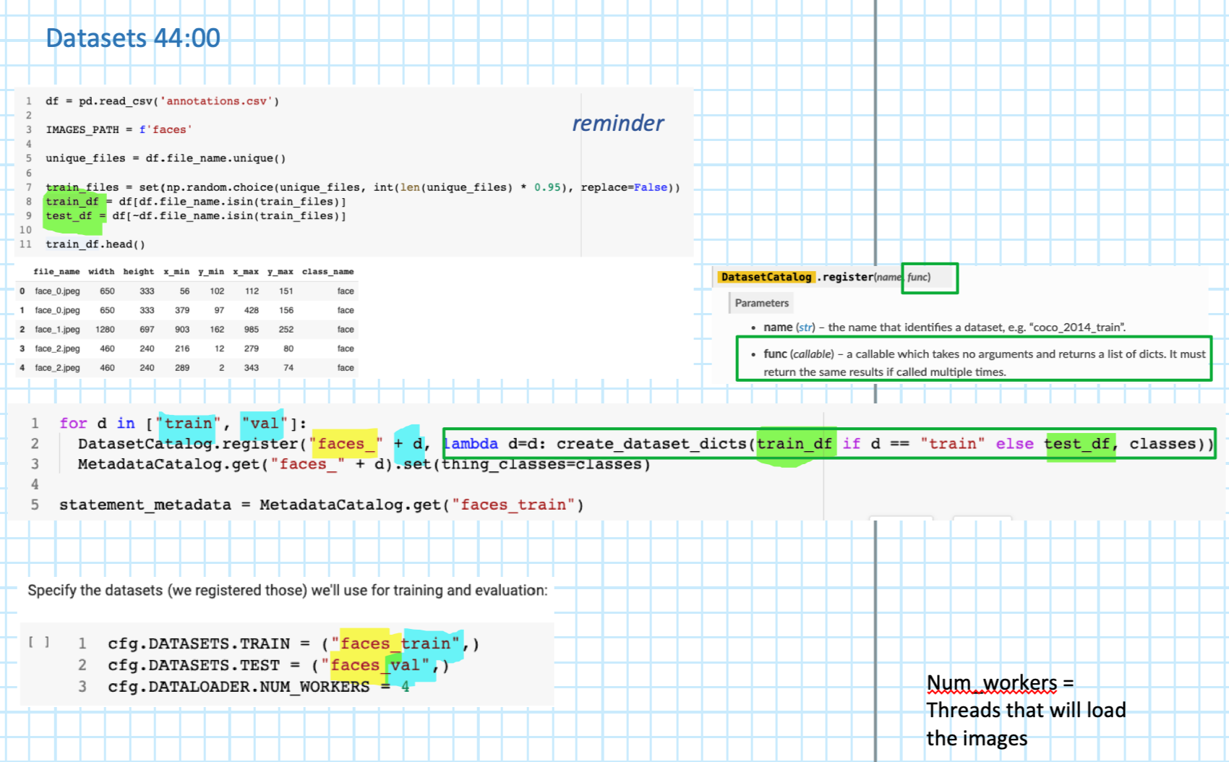
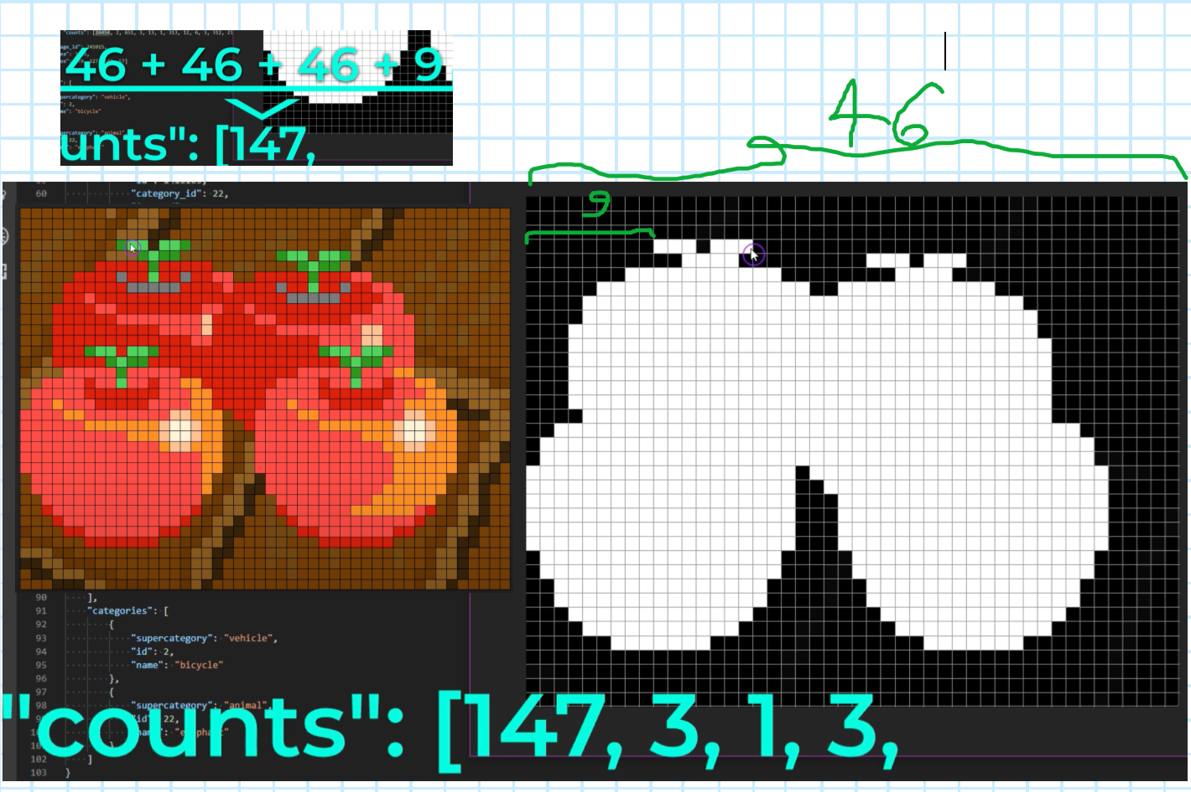
Drawings
Config Flie Learning Rate explenation

